Slide 1
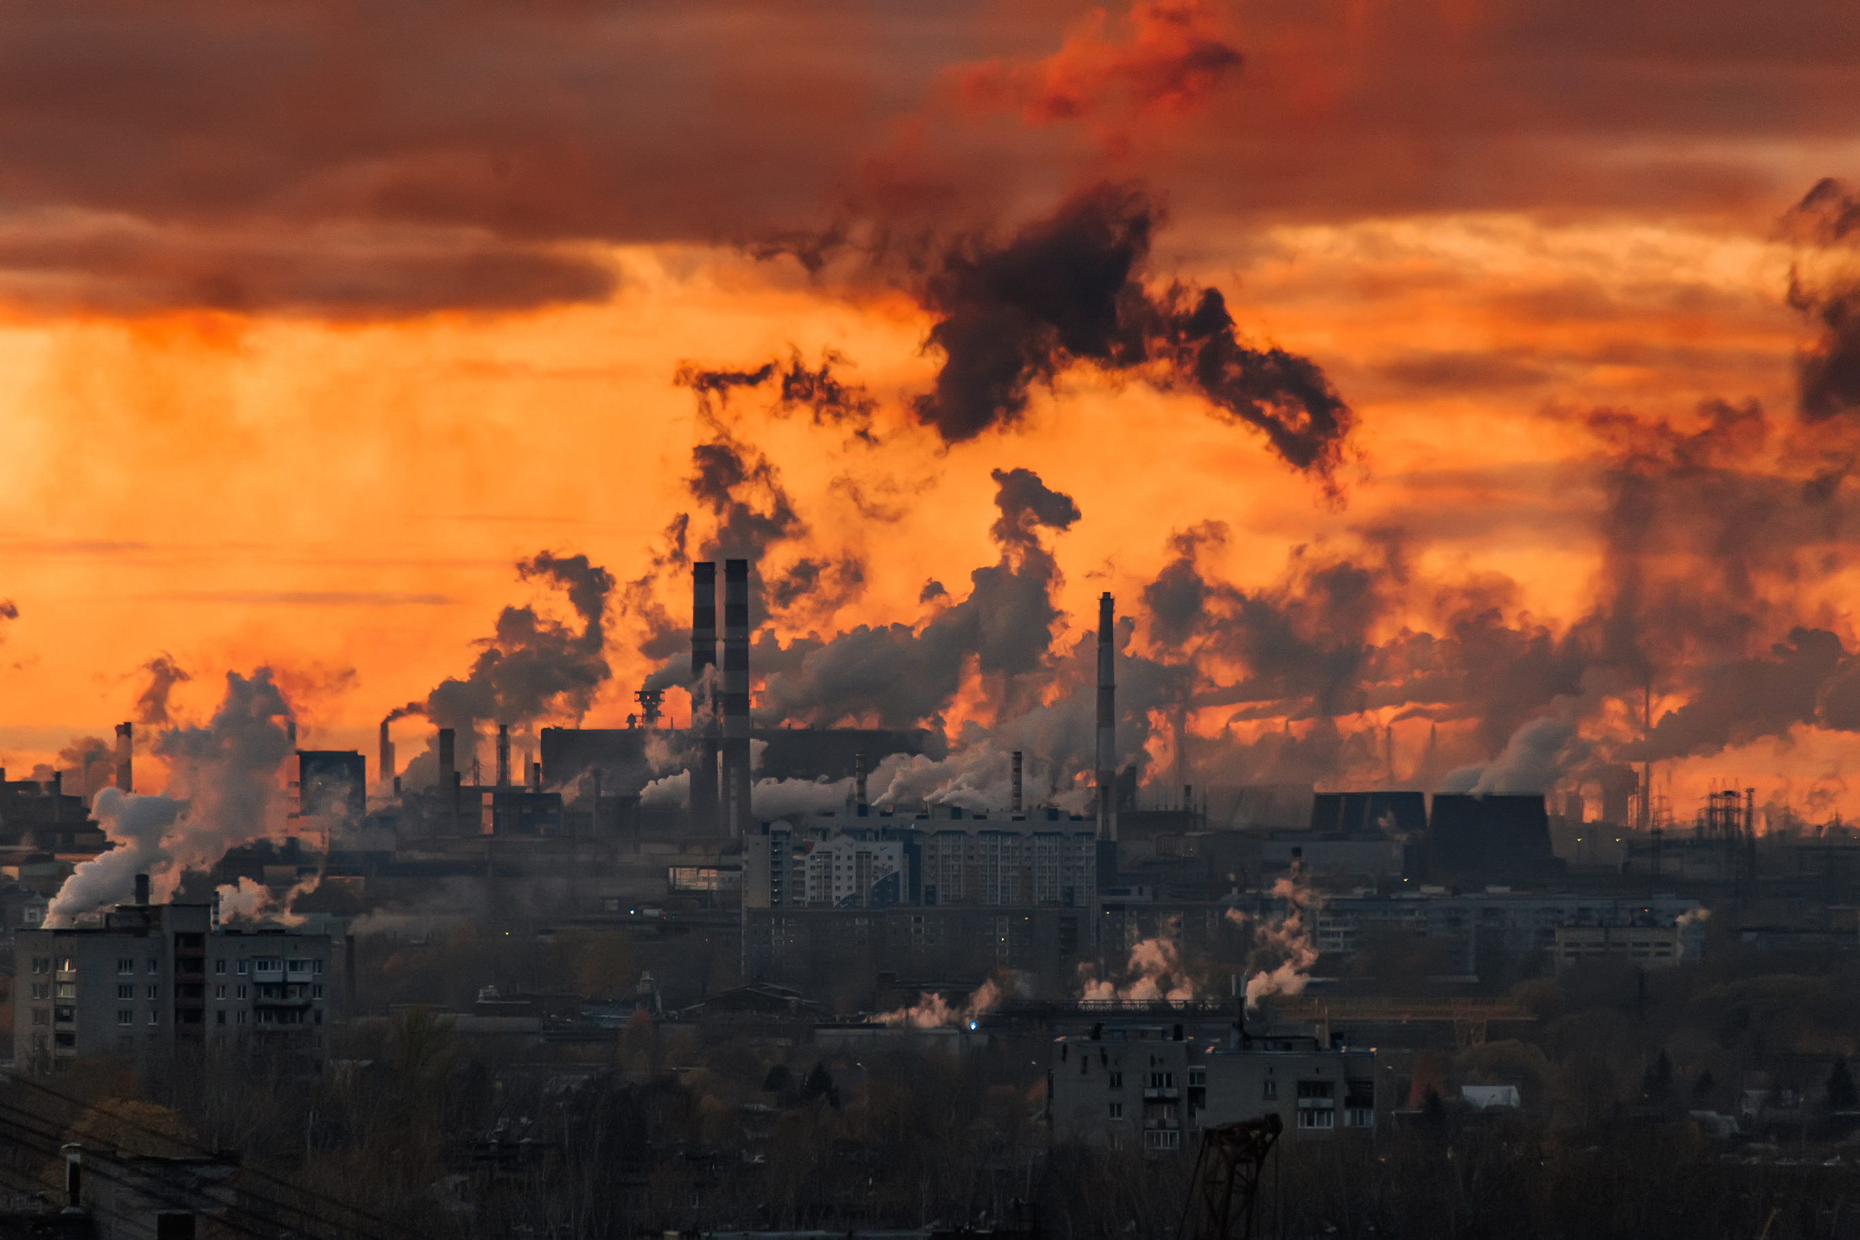



CO2 EMISSIONS
CO2
FORECASTING

Slide 2






OUR TEAM
EMMANS CHEPCHIENG
DAVID CLEMENT
ANGELLA WAMBUI
Scrum Master
Member
Member
JOE NGUNO
FAITH NJERI
DARREL GEORGE LUBULELA
Project Manager
Member
Member

Slide 3

Have you noticed how temperatures seem to be changing, and the seasons we once considered predictable no longer feel as predictable?

Slide 4



BUSINESS UNDERSTANDING
This project forecasts CO2 emissions for individual countries using historical emissions, economic, population, and energy data from Our World in Data (OWID) to support informed climate policymaking and planning.
The project is motivated by research cited in the notebook, including the IPCC(inter-governmental panel on climate change) Sixth Assessment Report on drivers of fossil-fuel CO₂ emissions and Costantini et al. (2024).
WHY
Understanding future CO₂ trends supports:
  Climate planning
  Cleaner-energy investment
  Better resource allocation

Slide 5

OBJECTIVES
MAIN
Predict CO2 emissions based on socioeconomic, energy and economic variables in country-level CO₂ forecasting.
SPECIFIC OBJECTIVES
  Estimate next year national emissions
  Identify countries with increasing or declining trends
  Support energy and climate planning
  Detect unusually large changes in emissions
  Prioritize countries for further investigation
  Compare expected emissions across major emitters

Slide 6

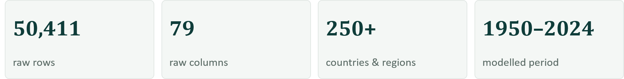
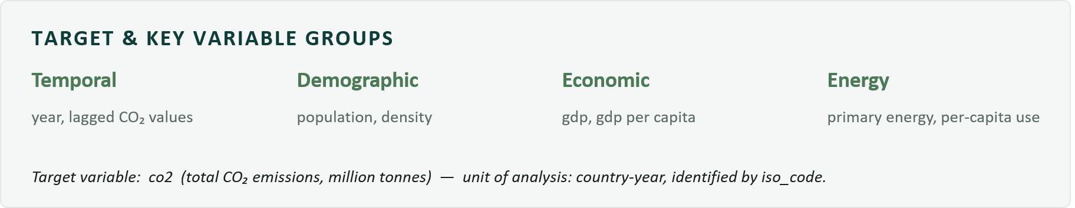
DATA UNDERSTANDING
The dataset cointains:
The target variable: CO2
because the purpose of the project is to forecast future national emissions. CO₂ is a measurable environmental outcome influenced by economic activity, population, energy consumption, and fuel use.
.

Slide 7
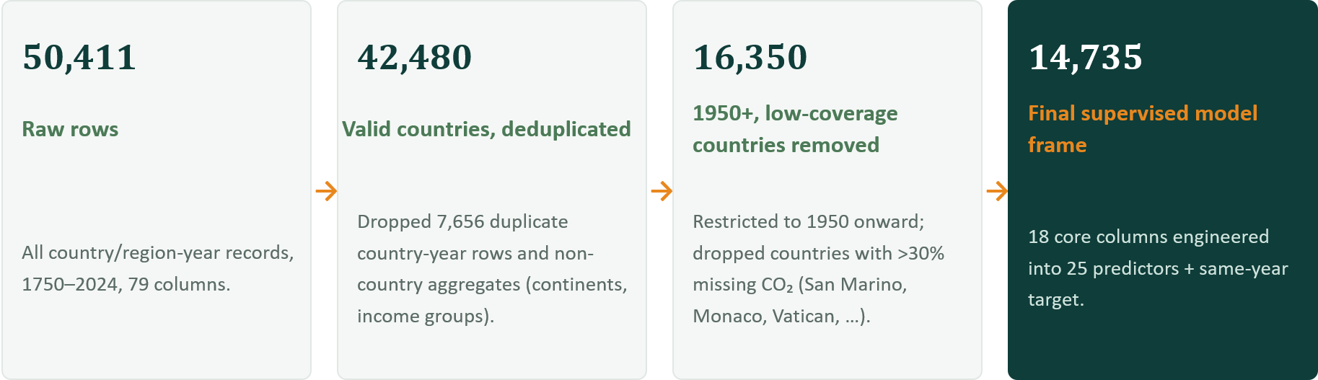
DATA CLEANING
infinite values converted to NaN; correlation used only as an exploratory screen, never as proof of causation.

Slide 8
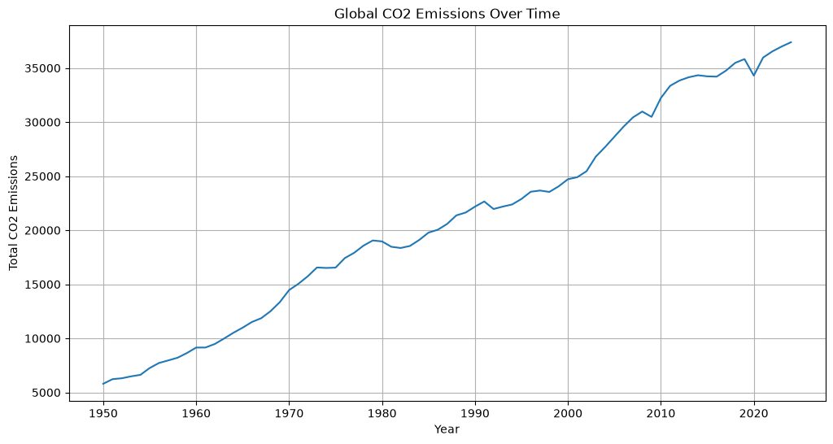
EXPLORATORY DATA ANALYSIS
Global CO₂ emissions show a strong long-term upward trend, rising substantially from 1950
to the most recent years.
The main noticeable declines
occur around the early 1980s and early 1990s, due to economic slowdowns and reduced energy demand. A sharper decline occurs around 2009 due to global financial crisis, while the largest recent drop is around 2020, largely due to COVID-19 that reduced transportation, industrial activity, and energy use.

Slide 9
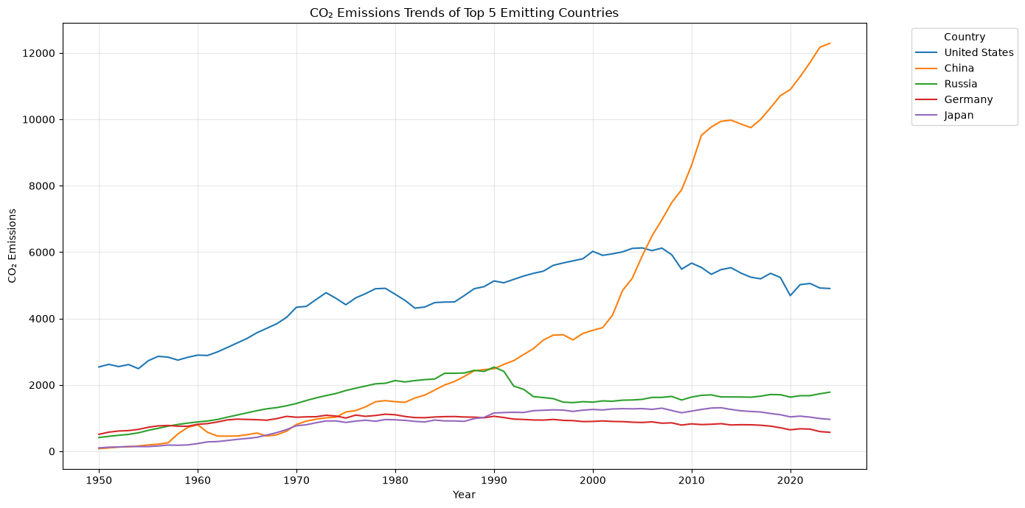
The United States experienced strong emissions growth historically, but its emissions have remained relatively stable and have declined in more recent years.
In contrast, China's CO₂ emissions increased rapidly, particularly from the early 2000s. This reflects China's rapid industrialization, economic growth, expansion of manufacturing, urbanization, and heavy dependence on coal for energy.

Slide 10
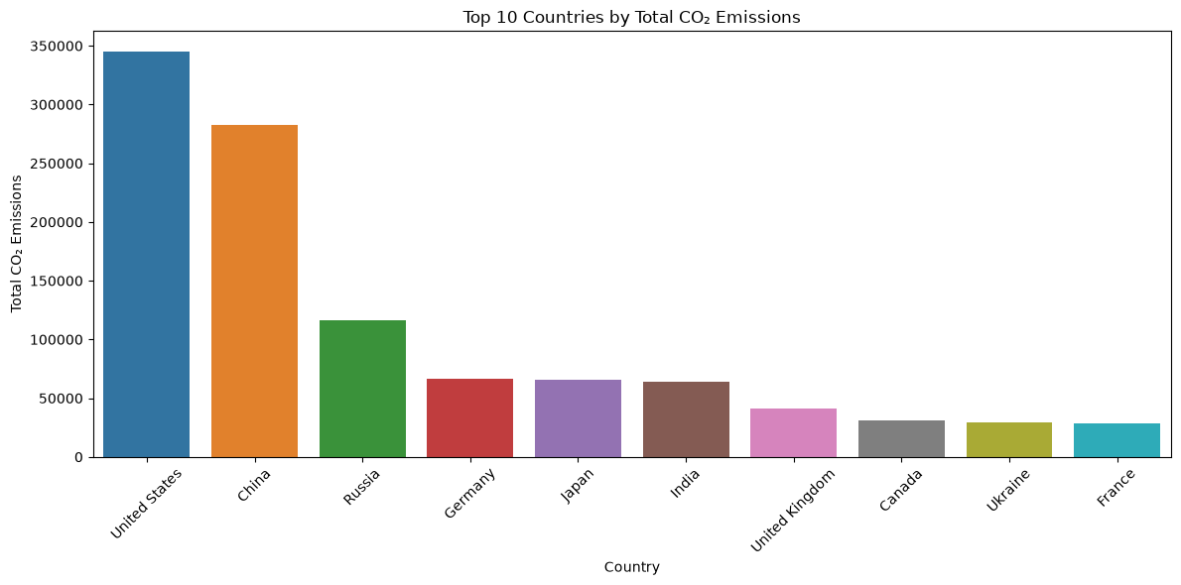
The analysis of cumulative CO₂ emissions shows that the United States is among the largest contributors to total emissions over the study period. This highlights the significant role of highly industrialized economies in historical global emissions and shows the large differences in emission levels across countries.

Slide 11
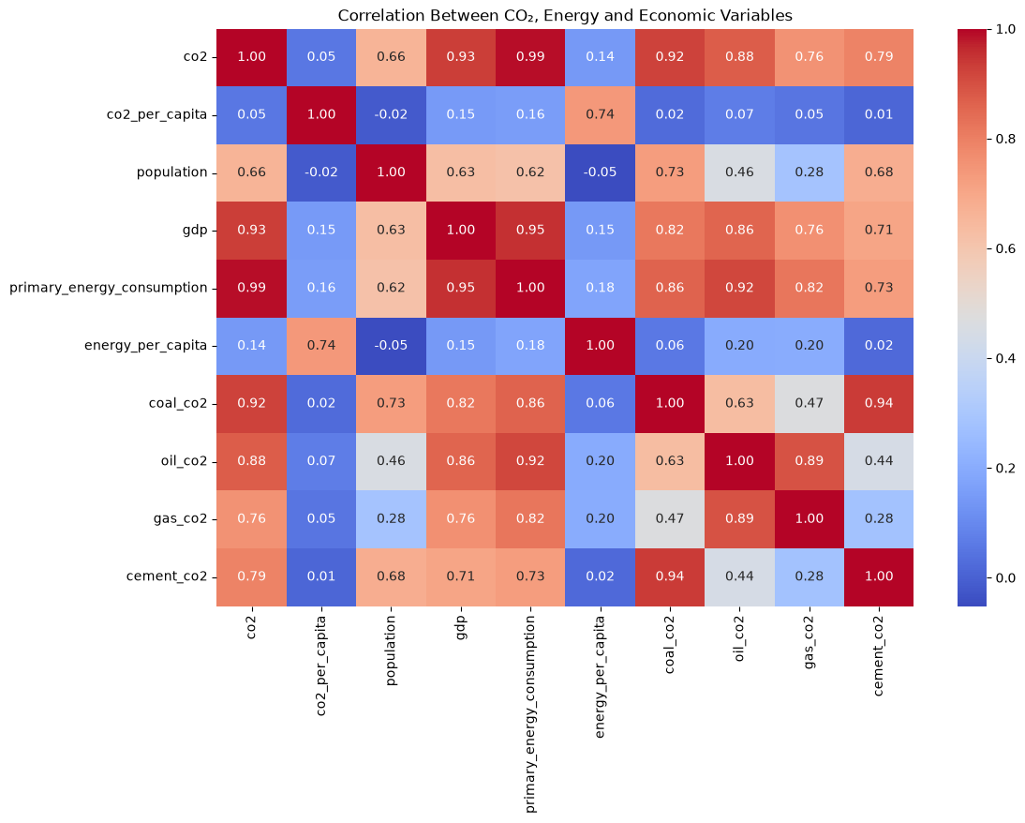
CO₂ emissions are strongly correlated with primary energy consumption and GDP, suggesting that higher economic activity and energy use are associated with higher emissions.
CO₂ also has strong relationships with coal, oil, and gas emissions. These results support the importance of economic activity, energy consumption, and historical emission patterns when developing the forecasting model.

Slide 12
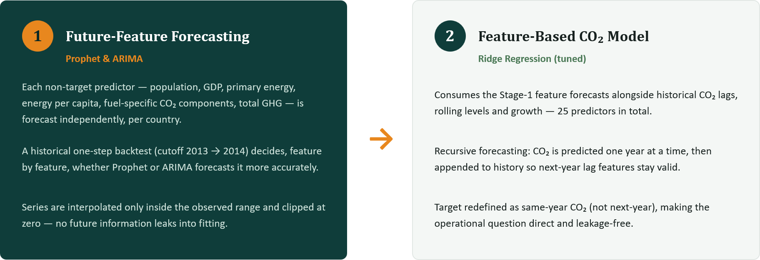
MODELING
Instead of assuming future GDP, population and energy values are already known, the pipeline forecasts them first — then feeds those forecasts into the CO₂ model.

Slide 13
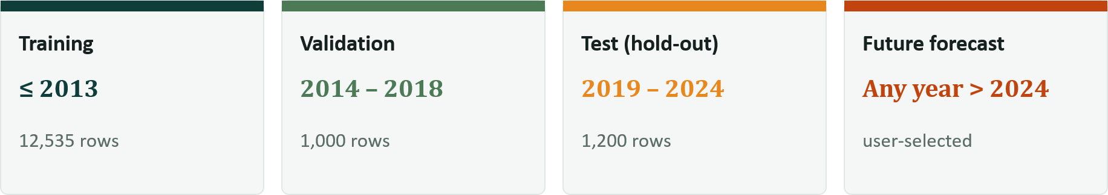
CHRONOLOGICAL EVALUATION
Only training + validation drive model selection and tuning. The test period (2019–2024) is touched exactly once, for final reporting and production forecasts recombine all observed years before predicting forward.

Slide 14
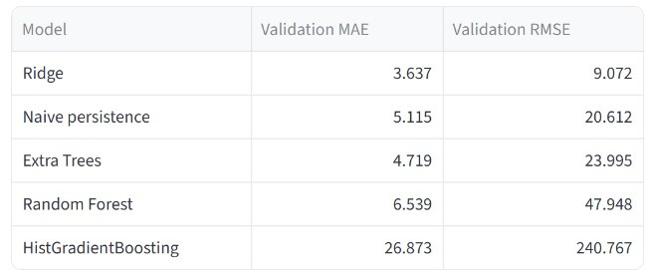
CHOOSING THE CO₂ MODEL ON VALIDATION PERFORMANCE
RIDGE REGRESSION
MAE: 3.637 RMSE: 9.072
The regularised linear model beats every nonlinear ensemble here the engineered relationships in this feature set are close to linear, and simpler models generalise better across the time based split.

Slide 15
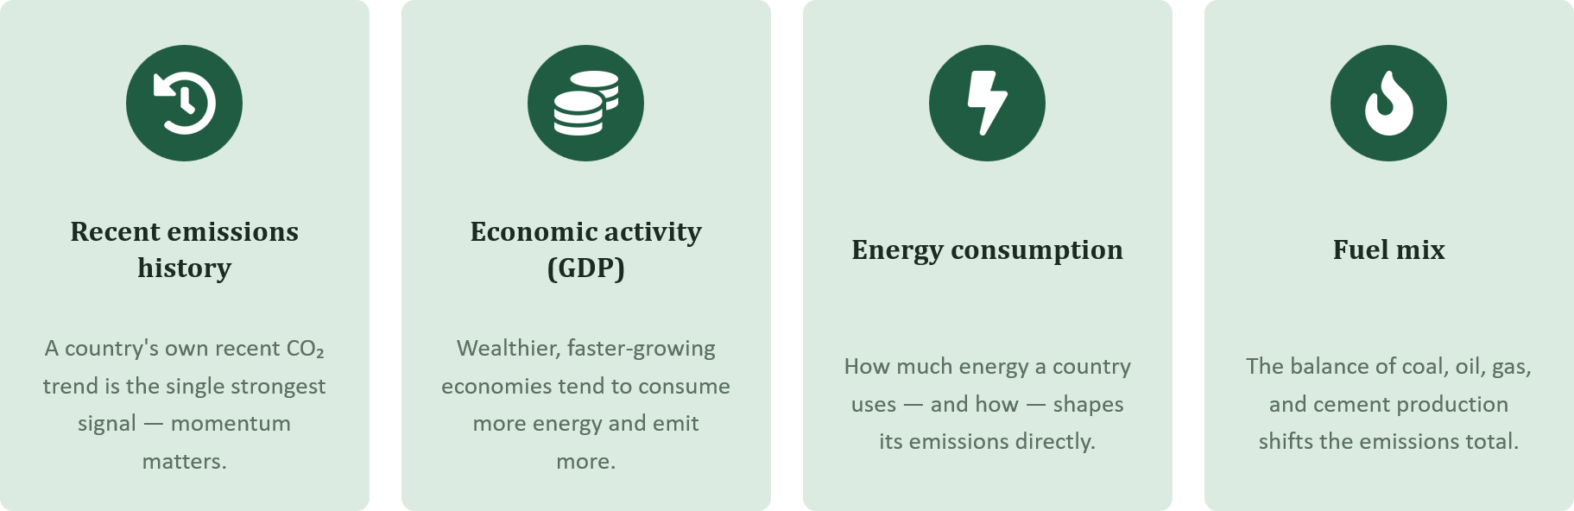
WHAT ACTUALLY MOVES THE FORECAST
Not every input matters equally. The model relies most heavily on:

Slide 16
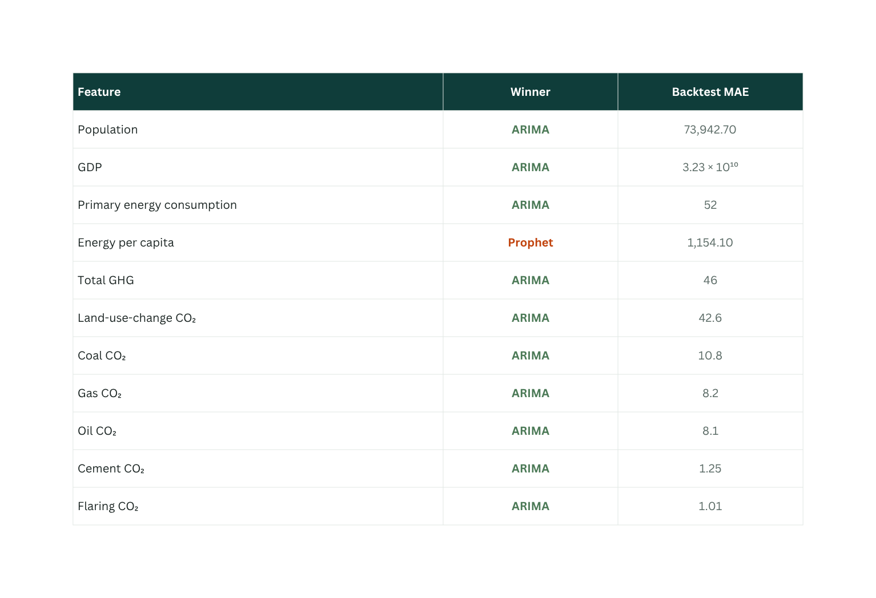
PROPHET VS. ARIMA
Most economic, energy and fuel-composition series here are smooth and trend dominated exactly where a classical ARIMA model excels.
Energy per capita is the one exception, where Prophet's seasonality/changepoint handling wins a reminder that the best method genuinely differs by series,.

Slide 17
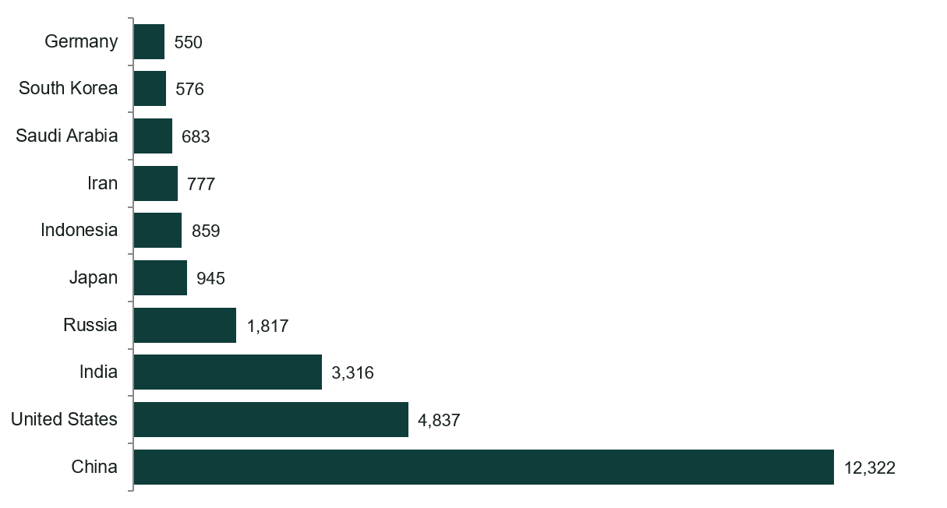
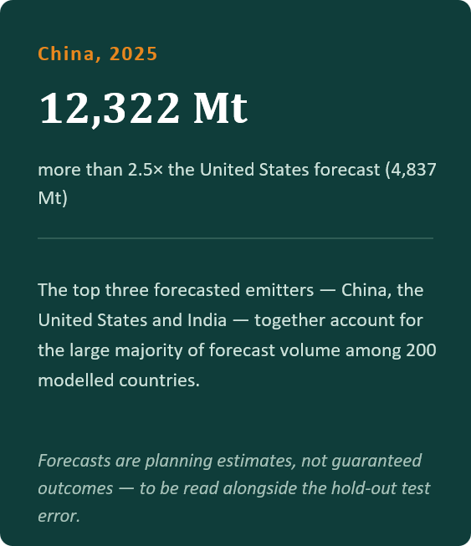
THE 2025 FORECAST: TOP CO2 EMITTING COUNTRIES

Slide 18
SUMMARY
  Validation RMSE: 31.8 Mt vs. 36.6 Mt for persistence baseline
  Covers 200 countries; forecasts any user-selected future year
Strengths
  Transparent & interpretable — uses economic, population, and fuel-mix data available at prediction time
  Beats persistence — goes beyond "future = recent past" by capturing structural drivers (per-capita trends, fuel switching, demographics)
  Policy-ready — no data leakage; genuine forecasting setup
DANI MARTINEZ
Job Title

Slide 19
LIMITATIONS
  Uneven historical coverage
  Missing data
  Structural breaks
  Limited policy and technology variables
  Linear model assumption
  Country-level differences
DANI MARTINEZ

Slide 20
RECOMMENDATIONS
  Add prediction intervals.
  propagate uncertainty.
  include policy and technological variables.
  explore hierarchical/multi-level models.
  periodically train the model.
  Develop what if scenerios
DANI MARTINEZ

Slide 21
CONCLUSION
Ridge remains the strongest feature-based model
Test MAE 6.11, RMSE 32.62, R² 0.999 on 2019–2024, refit on the full 1950–2024 record for production
ARIMA dominates feature forecasting
Non-CO₂ predictors are best forecast with ARIMA; Prophet wins only energy per capita.
Forecasts are decision support, not certainty
China, the US and India dominate the 2025 outlook treat every number alongside its hold-out error.

Slide 22

DEPLOYMENT

Slide 23


